Slide 1


Jacinto Diaz
October 09 2022

Slide 2

Outline
Executive Summary
Introduction
Methodology
Results
Conclusion
Appendix

Slide 3
Executive Summary
Summary of methodologies
Data Collection through API
Data Collection with Web Scraping
Data Wrangling
Exploratory Data Analysis with SQL
Exploratory Data Analysis with Data Visualization
Interactive Visual Analytics with Folium
Machine Learning Prediction
Summary of all results
Exploratory Data Analysis result
Interactive analytics result
Predictive Analysis result

Slide 4
Introduction
Project background and context
SpaceX advertises Falcon 9 rocket launches on its website with a cost of 62 million dollars. Other providers cost upward of 165 million dollars each, much of the savings is because SpaceX can reuse the first stage.
Problems you want to find answers
Predict if the first stage if of the SpaceX Flacon 9 rocket will land successfully.

Slide 5

Section 1

Slide 6
Methodology
Executive Summary
Data collection methodology:
SpaceX REST API using api.spacexdata.com/v4/.
Web scrapping from Wikipedia
Perform data wrangling
One Hot Encoding data fields for Machine Learning and data cleaning of null values and irrelevant column.
Perform exploratory data analysis (EDA) using visualization and SQL
Perform interactive visual analytics using Folium and Plotly Dash
Perform predictive analysis using classification models.
LR, KNN, SVM, DT models have been built and evaluated for the best classifier

Slide 7
Data Collection
The data was collected using various methods
Data collection was done using get request to the SpaceX API.
Next, we decoded the response content as a Json using .json() function call and turn it into a pandas data frame using .json_normalize().
We then cleaned the data, checked for missing values and fill in missing values where necessary.
In addition, we performed web scraping from Wikipedia for Falcon 9 launch records with BeautifulSoup.
The objective was to extract the launch records as HTML table, parse the table and convert it to a pandas data frame for future analysis.

Slide 8
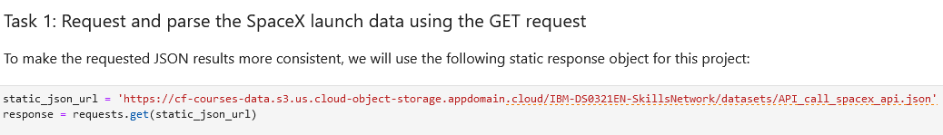
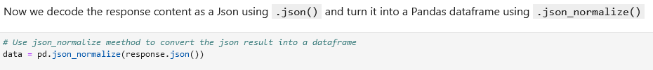
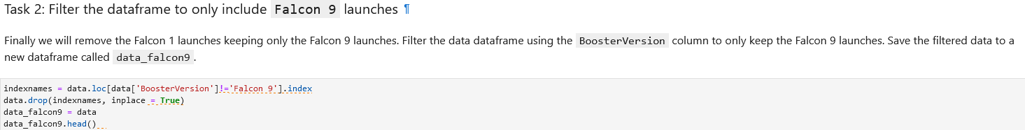
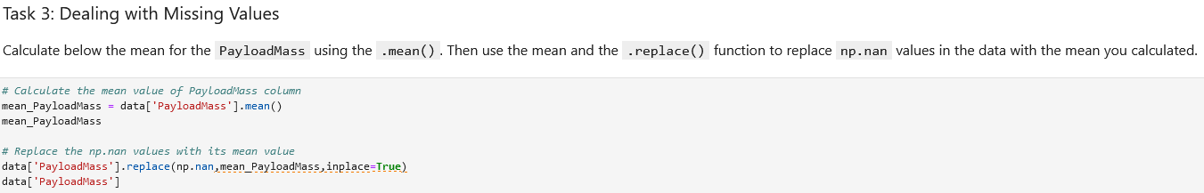
Data Collection – SpaceX API
We sent a get request to the SpaceX API, converted it into a Pandas dataframe. Filtered the data for Falcon9 launches and handled the missing values.
GitHub URL: GitHub URL https://github.com/jacint61/data-project/blob/main/jupyter-labs-spacex-data-collection-api.ipynb
..

Slide 9
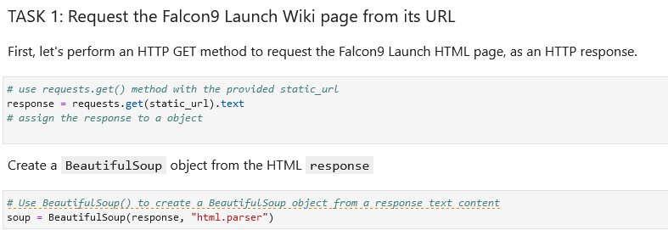
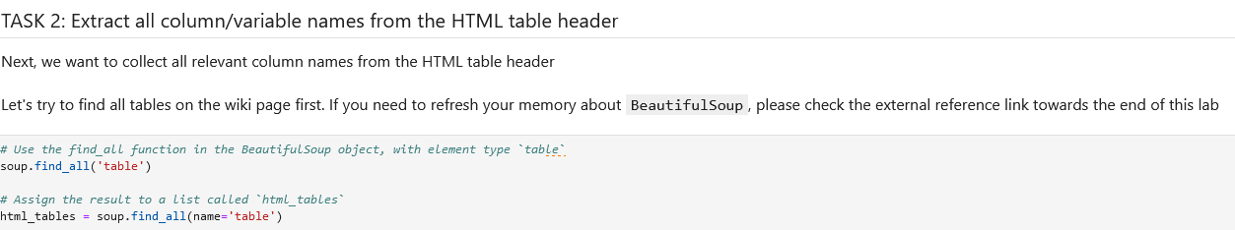
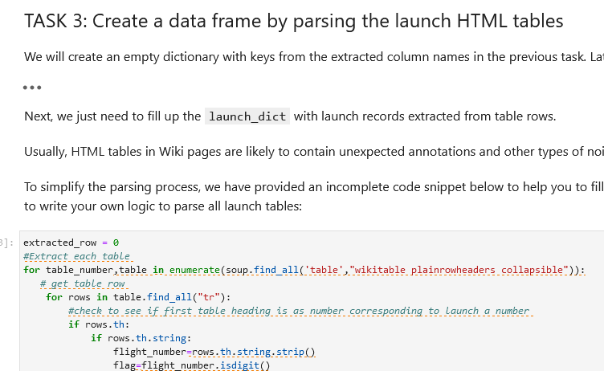
Data Collection - Scraping
We used BeautifulSoup to web scrap, extracted the column names and converted the data into a Pandas Dataframe.
GitHub URL of the web scraping notebook:
https://github.com/jacint61/data-project/blob/main/Lab%202%20-%20jupyter-labs-webscraping.ipynb

Slide 10

Data Wrangling
Use the method value_counts() on the columns LaunchSite, Orbit and Outcomes to determine the occurrences of each.
Created a bad outcome set to separate bad outcomes from the successful ones.
Created “Class” column to show the outcome.
We provide Class value =0 for bad outcomes.
We provide Class value =1 for successful outcomes.
GitHub URL : https://github.com/jacint61/data-project/blob/main/labs-jupyter-spacex-Data%20wrangling.ipynb

Slide 11
EDA with Data Visualization
We plotted Scatter Plots for the following :
Flight Number v/s Launch Sites
Payload v/s Launch Sites
Flight Number v/s Orbits
Payload v/s Orbits
We used scatter plots to see the relation between these two features for each.
We plotted Bar Chart for Orbits to show the success rate of each.
We plotted Line Chart to see how average success ratio changed with years.
GitHub URL : https://github.com/jacint61/data-project/blob/main/jupyter-labs-eda-dataviz.ipynb

Slide 12
EDA with SQL
We performed EDA with SQL queries to get insights from data. The queries were:
Display names of each unique launch site in the space mission.
Display 5 records where launch sites begin with the string 'CCA‘
Display the total payload mass carried by boosters launched by NASA (CRS)
Display average payload mass carried by booster version F9 v1.1
List the date when the first successful landing outcome in ground pad was acheived
List the names of the boosters which have success in drone ship and have payload mass greater than 4000 but less than 6000
List the total number of successful and failed outcomes
List the names of the booster versions which have carried the maximum payload mass.
List the records which will display the month names, failure landing outcomes in drone ship ,booster versions, launch site for the months in year 2015.
Rank the count of successful landing outcomes between the date 04-06-2010 and 20-03-2017 in descending order
GitHub URL : https://github.com/jacint61/data-project/blob/main/jupyter-labs-eda-sql-coursera_sqllite.ipynb

Slide 13
Build an Interactive Map with Folium
We marked all launch sites and added map markers to mark the success and failure of each launch from the different sites.
We assigned class label 0 and 1 for failure and success outcome respectively.
Calculated distances between the launch sites and its proximities like coastline, highway and city.
To see if launch sites keep away from cities?
To see if they are close to coastlines?
How are they connected with highways and railways?
GitHub URL :

Slide 14
Build a Dashboard with Plotly Dash
We built an interactive dashboard with Plotly Dash.
A dropdown menu with options to either select all or specific launch sites
A pie chart showing total successful launches for all sites or to show a pie chart between successful and failure ratio from specific sites.
We added a payload range slider to select a range of payload mass.
We plotted a scatter plot between outcome and payload mass picked from slider.
GitHub URL:

Slide 15
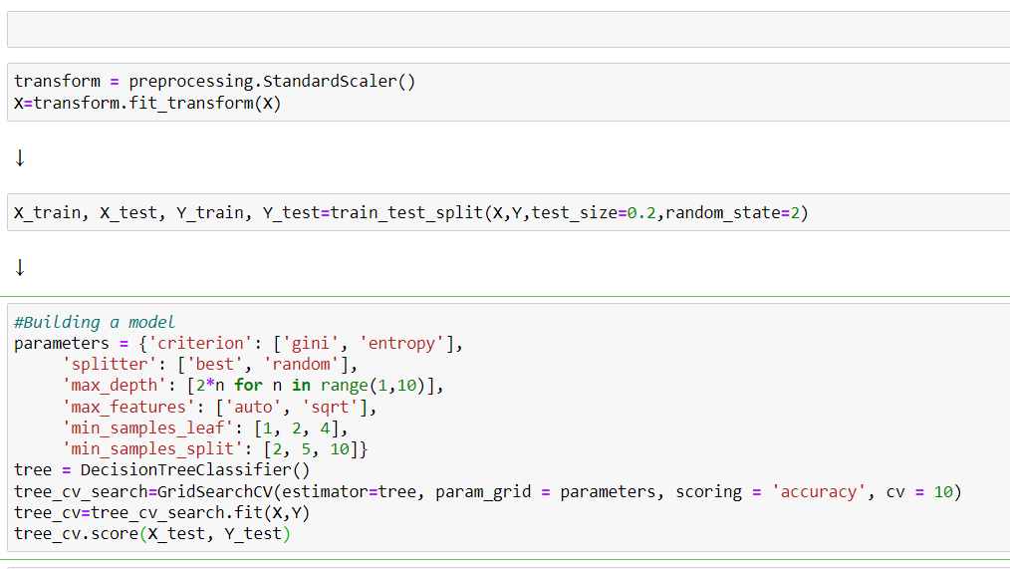
Predictive Analysis (Classification)
We loaded the data using numpy and pandas. Transformed the data using StandardScaler().
We split the data into train and test data with test size 0.2
We built different ML models and found best hyperparameters using GrisdSearchCV.
We found the best performing model.
GitHub URL :

Slide 16
Results
Exploratory data analysis results
•Space X uses 4 different launch sites;
•The first launches were done to Space X itself and NASA;
•The average payload of F9 v1.1 booster is 2,928 kg;
•The first success landing outcome happened in 2015 fiver year after the first launch;
•Many Falcon 9 booster versions were successful at landing in drone ships having payload above the average;
•Almost 100% of mission outcomes were successful;
•Two booster versions failed at landing in drone ships in 2015: F9 v1.1 B1012 and F9 v1.1 B1015;
•The number of landing outcomes became as better as years passed.
Interactive analytics demo in screenshots
Predictive analysis results
Predictive analysis showed that Decision Tree Classifier is the best classification model for our data with accuracy of 90%.
Only 1 case each of False Positive and False Negative.

Slide 17
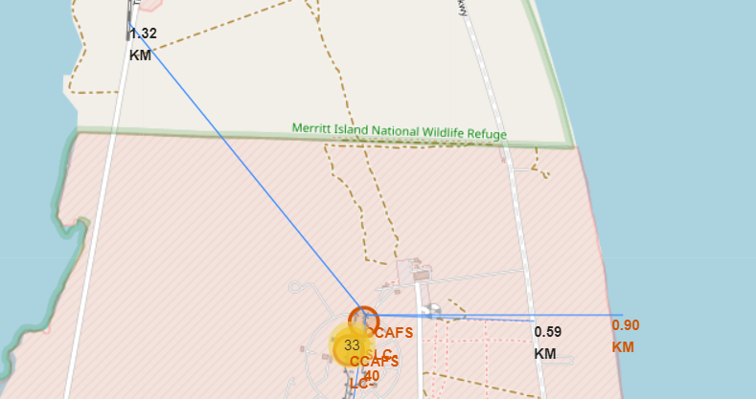
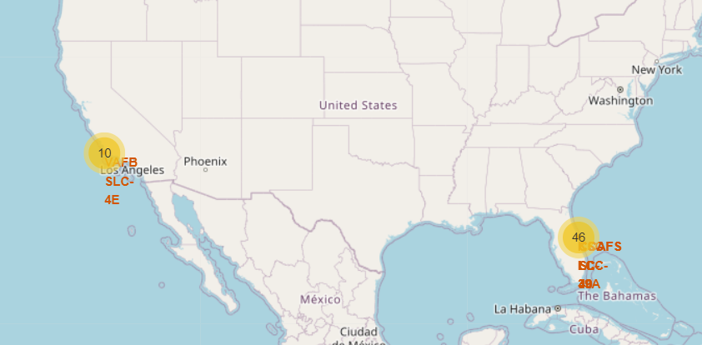
Results
Interactive analytics demo in screenshots
Using interactive analytics was possible to identify that launch sites use to be in safety places, near sea, for example and have a good logistic infrastructure around.
Most launches happen at east coast line.

Slide 18

Section 2

Slide 19
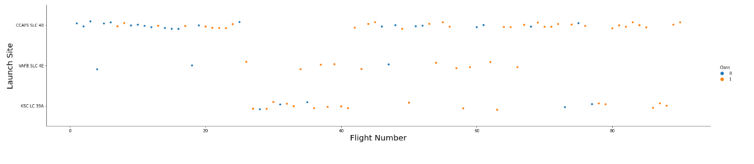
Flight Number vs. Launch Site
The larger the flight amount at a launch site, the greater the success rate at a launch site.

Slide 20
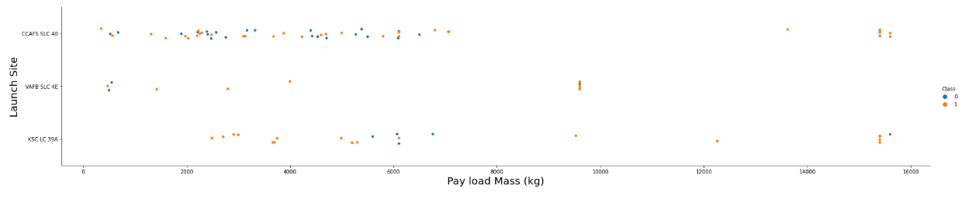
Payload vs. Launch Site
We see that with high payload mass we have more points with data label 1.
This shows that launches with high payload mass have more chances for successful outcome than a low payload mass launch.

Slide 21
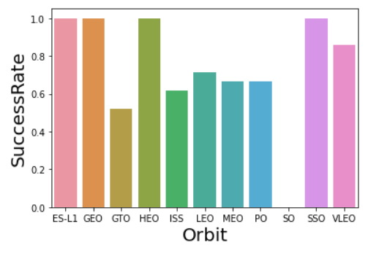
Success Rate vs. Orbit Type
From the plot, we can see that ES-L1, GEO, HEO, SSO, VLEO had the most success rate.

Slide 22
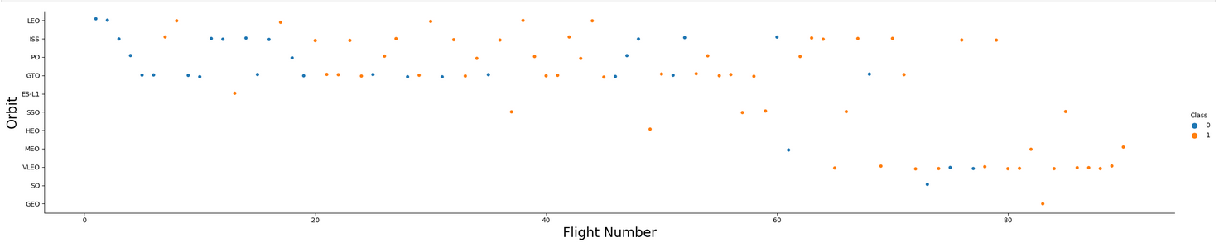
Flight Number vs. Orbit Type
The plot below shows the Flight Number vs. Orbit type. We observe that in the LEO orbit, success is related to the number of flights whereas in the GTO orbit, there is no relationship between flight number and the orbit.

Slide 23
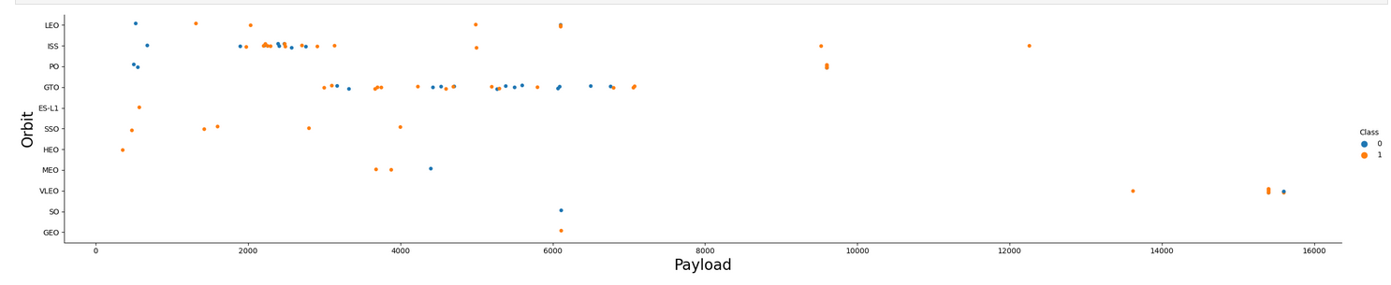
Payload vs. Orbit Type
With heavy payloads the successful landing or positive landing rate are more for Polar, LEO and ISS.
However for GTO we cannot distinguish this very well as both of the positive landing rate and negative landing(unsuccessful mission) are there.

Slide 24
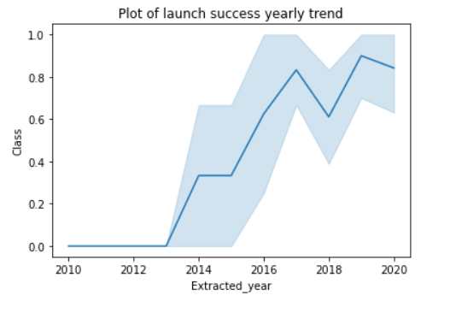
Launch Success Yearly Trend
We see that success rate has been on a rise since year 2013.
However, there was a downfall for success rate in the year 2018.

Slide 25
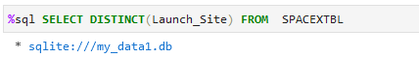
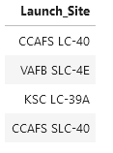
All Launch Site Names
We select DISTINCT launch sites from the table.
We get these 4 outcomes as unique Launch Sites.

Slide 26
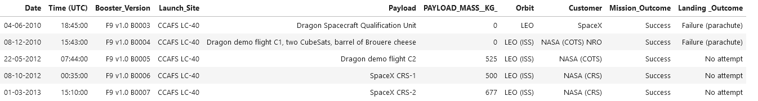
Launch Site Names Begin with 'CCA'
We display first 5 record where the Launch Sites begin with CAA using LIKE operation.

Slide 27
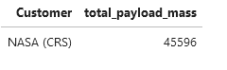
Total Payload Mass
We calculate the total payload mass (kg) carried by boosters launched by NASA and get the value of 45 596 KG.

Slide 28
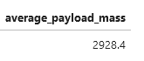
Average Payload Mass by F9 v1.1
We calculate the average payload mass (kg) carried by booster version F9 v1.1 and get the value of 2928 KG.

Slide 29
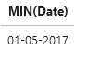
First Successful Ground Landing Date
We calculate the earliest date for a successful landing on a ground pad and get the date as 2017-05-01.

Slide 30
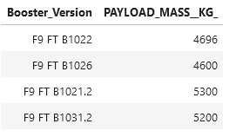
Successful Drone Ship Landing with Payload between 4000 and 6000
We list the booster versions which have a successful landing on a drone ship and the Payload is between 4000-6000 KG.

Slide 31
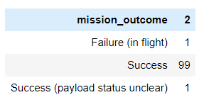
Total Number of Successful and Failure Mission Outcomes
We calculate total successful and failure mission outcomes and get 100 Successful mission and 1 Failure mission.
We do so by using GROUP BY operation in our query.

Slide 32
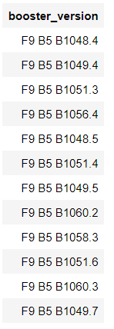
Boosters Carried Maximum Payload
We display the boosters that carried maximum payload weight and get these values.
We do so by using a SUB QUERY in our query and use MAX operation in that sub query.

Slide 33
2015 Launch Records
We display booster version, launch site and the landing outcome for failed landing outcome in 2015. We get the result as shown.
We do so by using BETWEEN in our query.

Slide 34
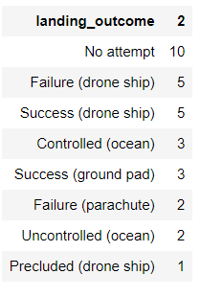
Rank Landing Outcomes Between 2010-06-04 and 2017-03-20
We landing outcome, and their occurrences between specified dates. We get this output as shown.
We do so by using COUNT BETWEEN ORDER BY & GROUP BY in our query.

Slide 35

Section 3

Slide 36
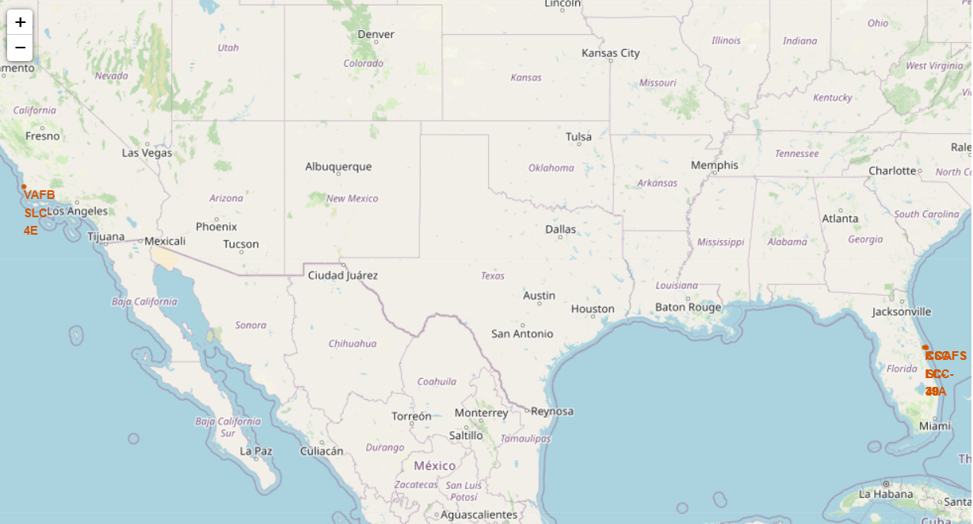
Launch Sites on Map of USA.
We see that the SpaceX’s Launch sites are in United States of America.
All launch sites are in coastal region.

Slide 37

Markers showing launch sites with color labels

Slide 38

Launch Site distance to landmarks

Slide 39

Section 4

Slide 40
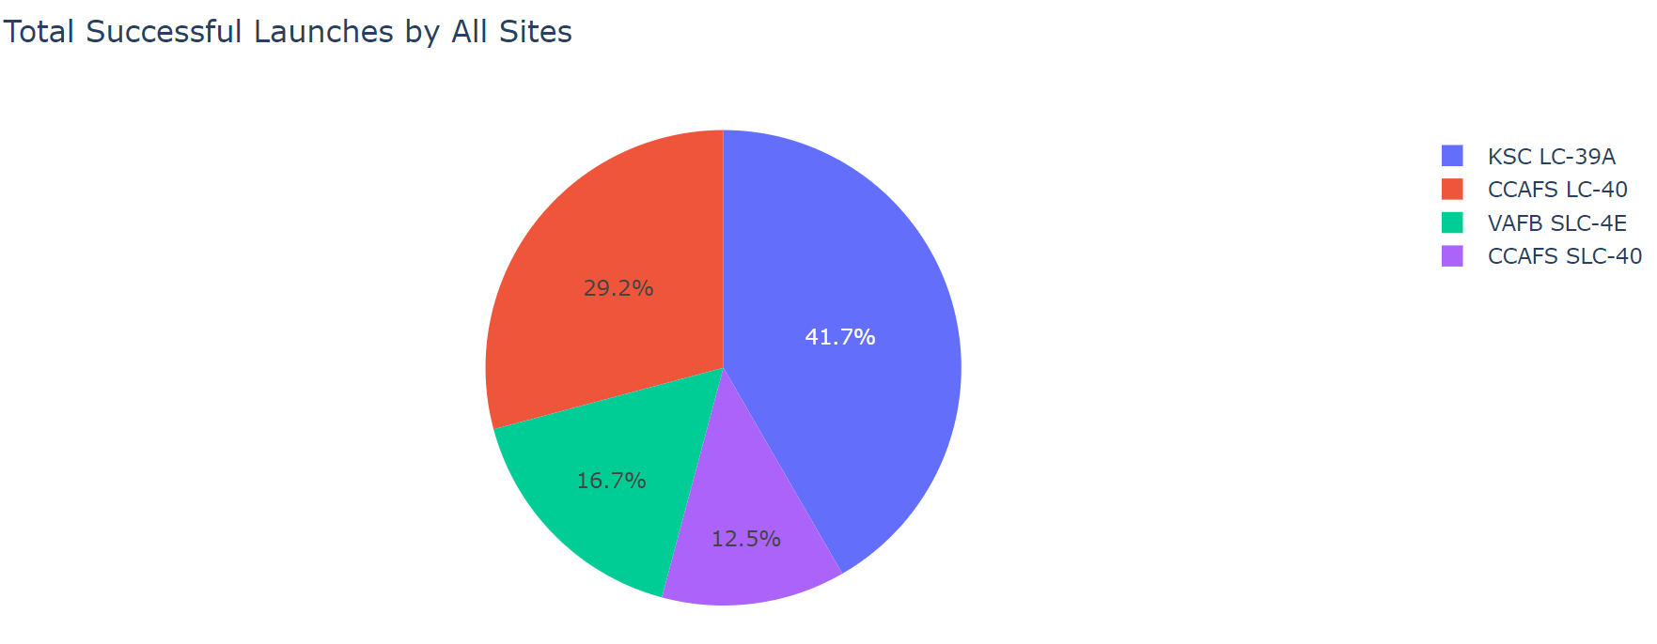
Pie Chart for Successful Launches for All Sites
We can see that KSC LC-39A has highest number of successful launches. We also see that CCAFS SLC-40 has lowest number.

Slide 41
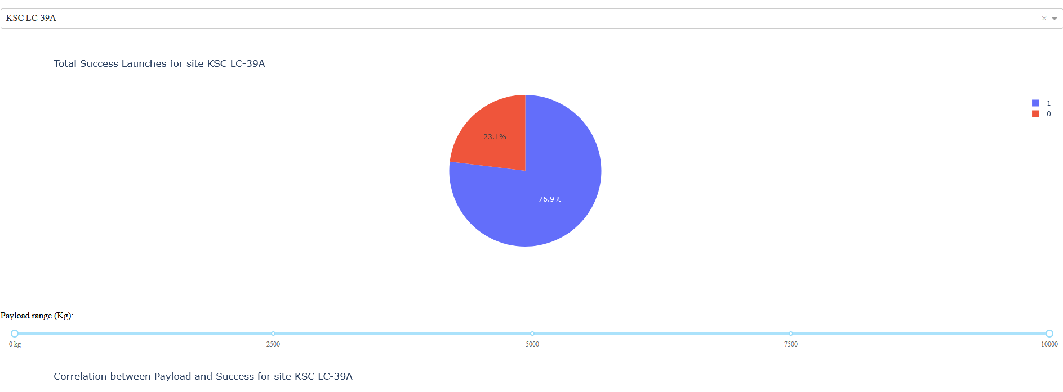
Pie Chart for Success ratio of KSC LC-39A
We plot the pie chart for KSC LC-39A and observe that it has success rate of 76.9 %

Slide 42

Scatter plot of Payload vs Launch Outcome for all sites, with different payload selected in the range slider

Slide 43

Section 5

Slide 44

Classification Accuracy
The decision tree classifier is the model with the highest classification accuracy
The decision tree classifier is the model with the highest classification accuracy

Slide 45
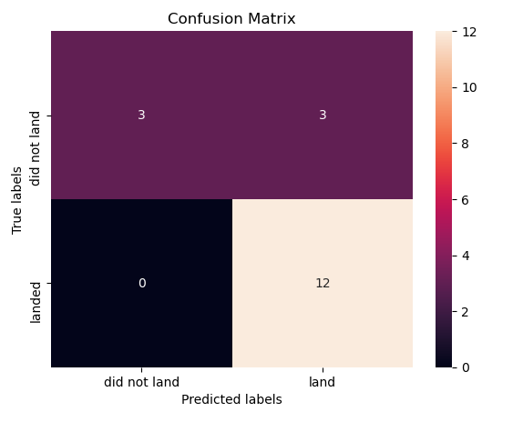
Confusion Matrix
Confusion Matrix for Decision Tree Classifier shows it has 12 True-Positive and 3 True-Negative.

Slide 46
Conclusions
The larger the flight amount at a launch site, the greater the success rate at a launch site.
Launch success rate started to increase in 2013 till 2020.
Orbits ES-L1, GEO, HEO, SSO, VLEO had the most success rate.
Launch site KSC LC-39A has highest success rate and highest number of successful launches.
Decision Tree Classifier is the best model for classification whether launch is successful or not.

Slide 47


